Slide 1
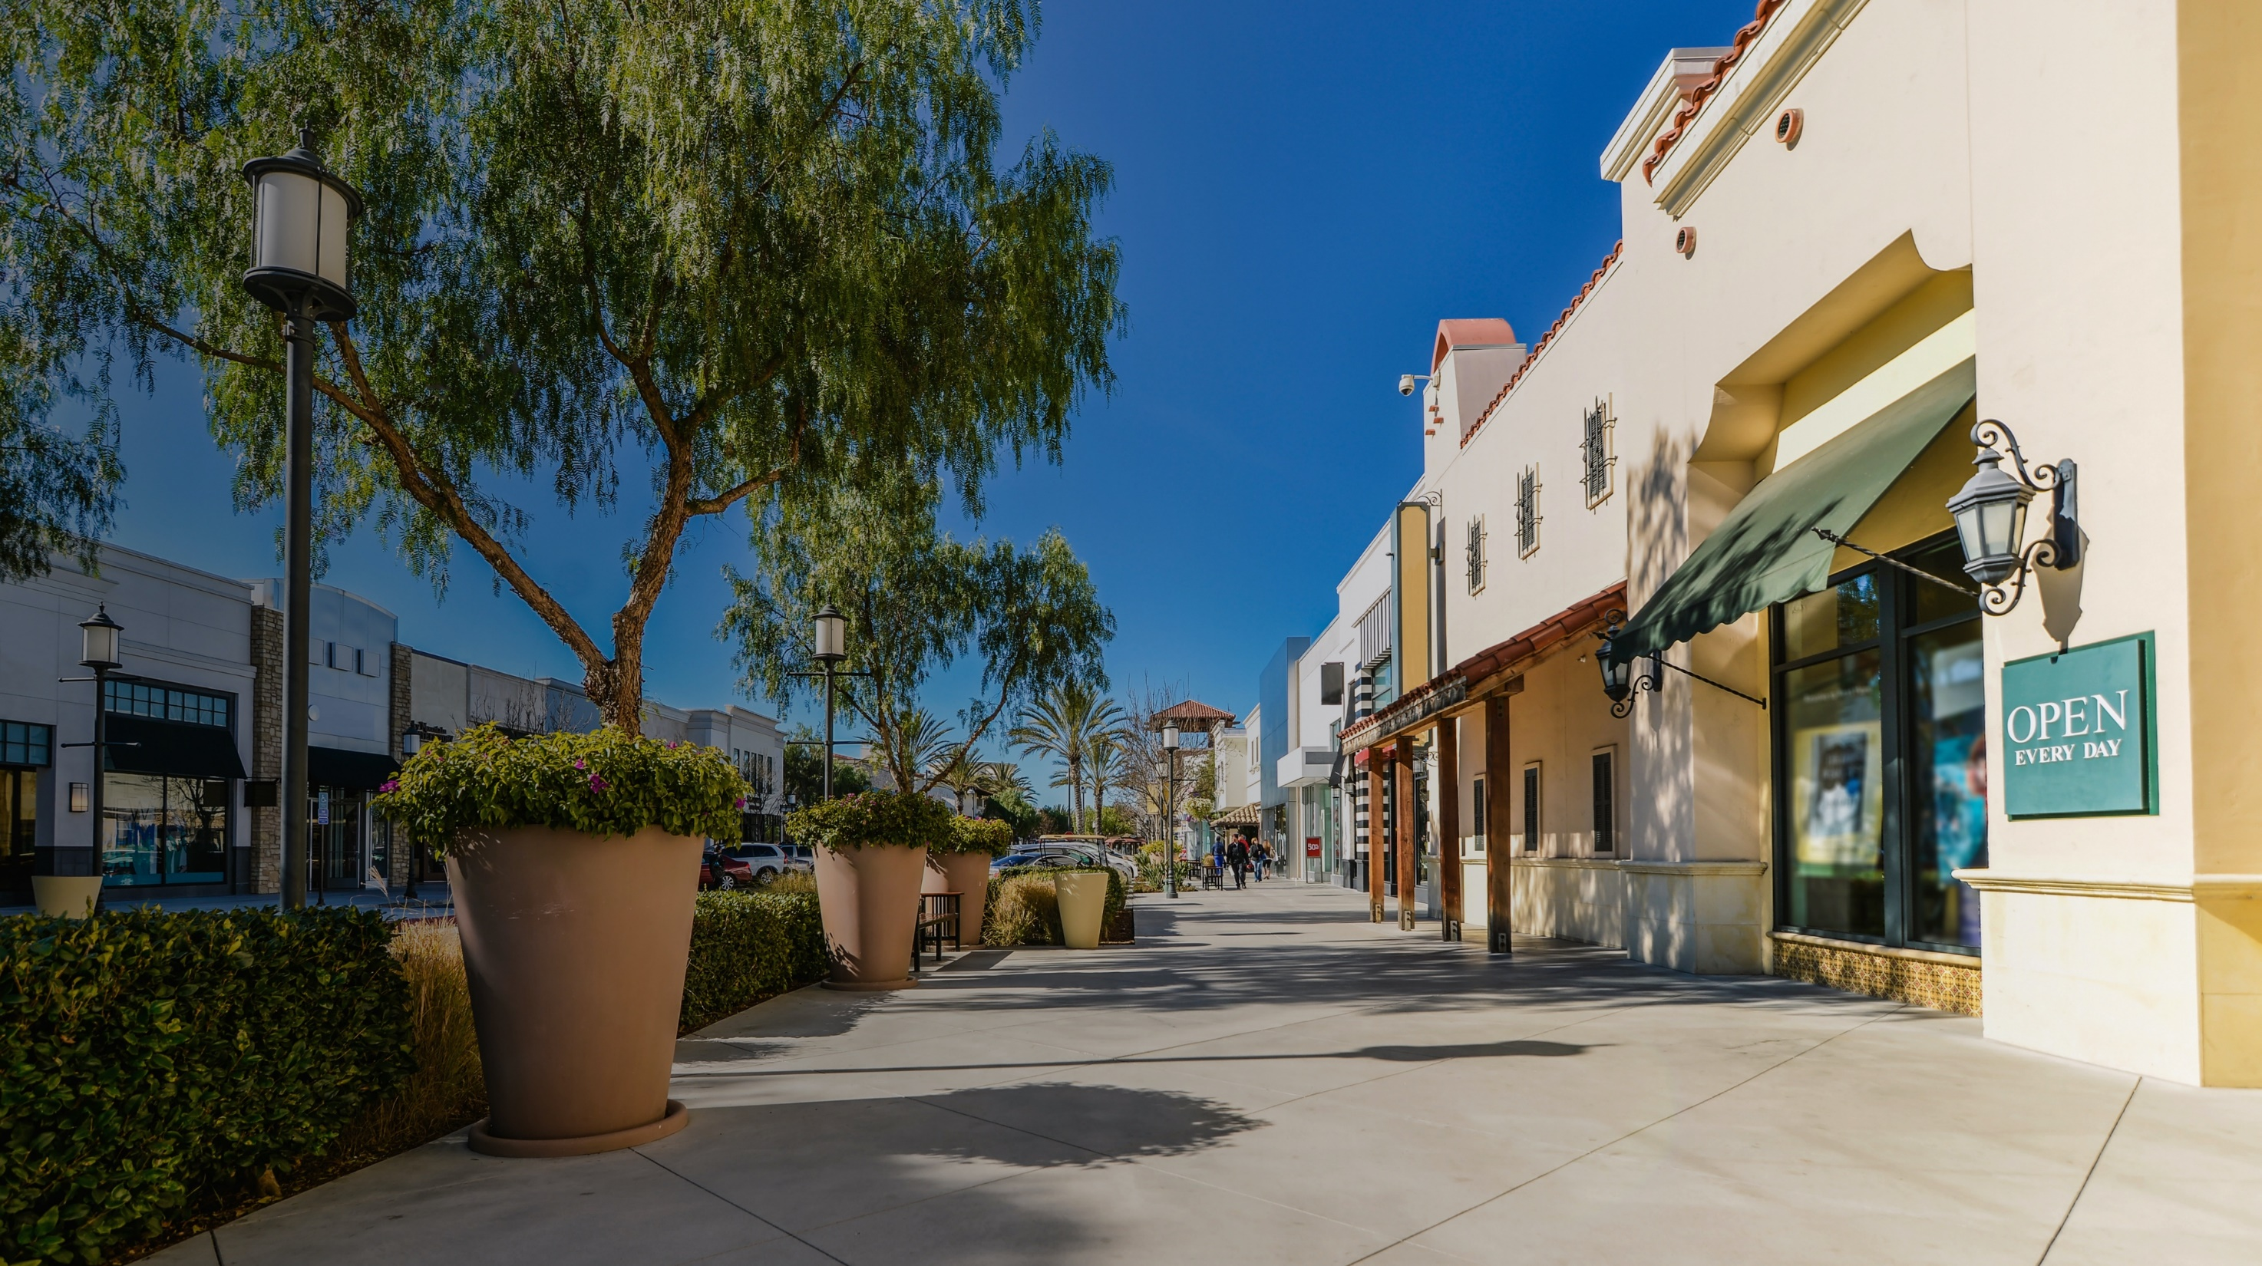

September 21, 2021
Honeywell
Small and
Medium Building Administrator
Powered by Honeywell Forge

Slide 2
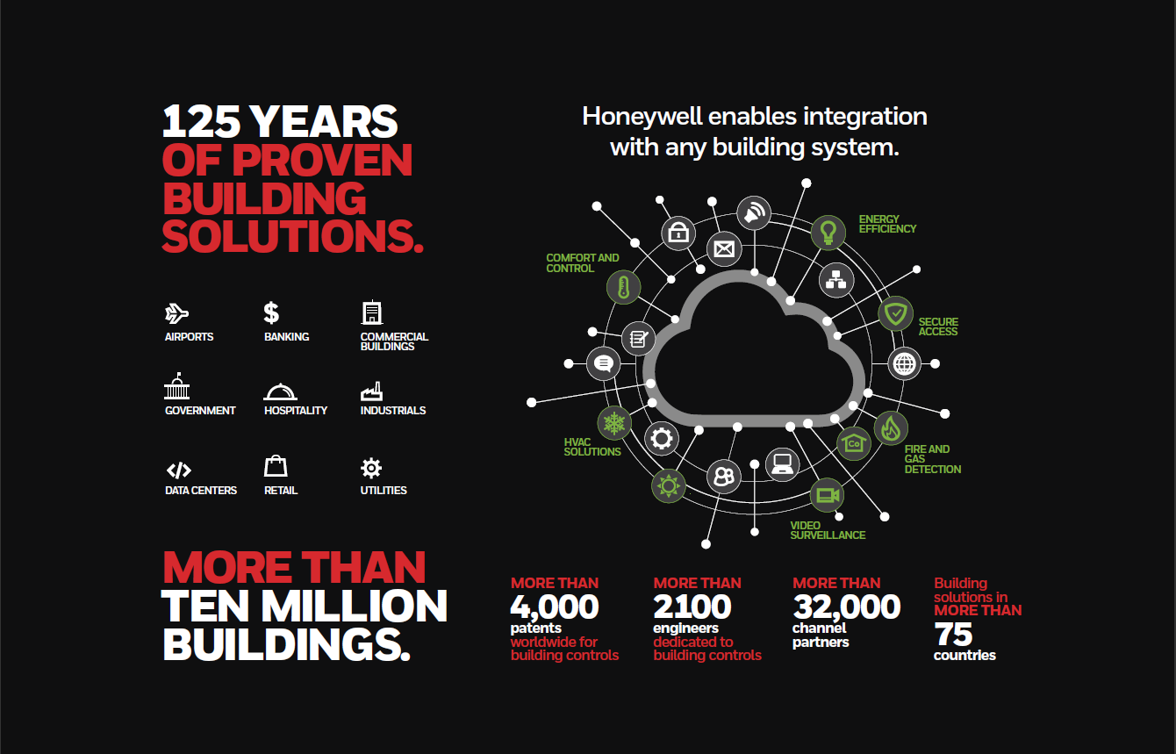
Notes:
With Honeywell solutions in more than 10 million buildings and facilities worldwide, we understand the challenges of managing commercial buildings whether those buildings or facilities are Airports, hospitals, industrials, hotels and so on –
At Honeywell we are experts in driving: CONNECTIVITY, PRODUCTIVITY, EFFICIENCY, SECURITY, AND SAFETY! And enable integration with any building system.
With a large portfolio of building control and automation solutions, and with over 32,000 partners worldwide, we can bring those solutions to you were ever you are.

Slide 3

Business Disruption happens honeywell is ready to assist
Honeywell Confidential - ©2020 by Honeywell International Inc. All rights reserved.
Notes:
At Honeywell, we constantly talk to facility Managers and property owners and understand their daily challenges to manage a portfolio of buildings and deliver
Increased occupant comfort and experience
Increased Operational and energy Efficiency
And lets face it, at the best of time, those challenges can feel that they are stretching! But 2020 has added a whole new set of complexity and has been a rough year.
Challenges have not changed, however, the increased complexity brought in by the need to keep businesses running in those unprecedented times has meant that priorities have shifted and the plans that where agreed have had to change and evolve, multiple times in some cases and often at very short notice – requiring business owners and facility managers to operate with a high level of flexibility and agility.

Slide 4
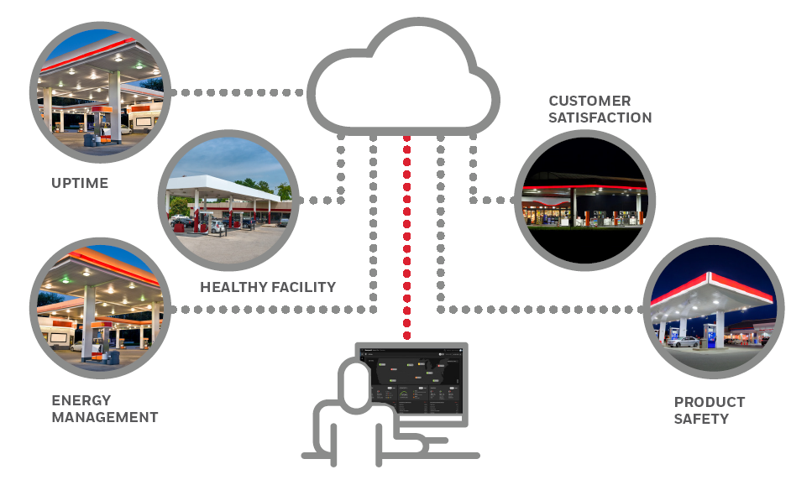
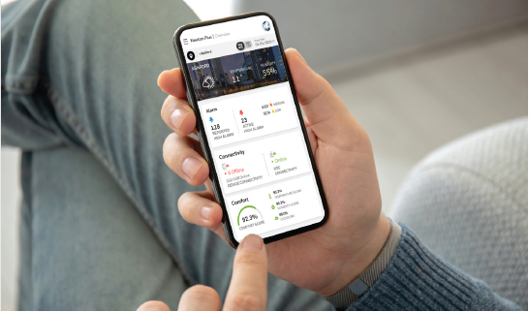
Hello honeywell SMB
Honeywell SMB is a hardware and software solution that has been specifically designed for your Small and Medium Building enterprise.
Powered by Honeywell Forge
Subscription Based
Scalable to fit your needs
Enabling you to Connect, Manage, and Automate your facilities infrastructure.
Notes:
Whilst in larger facilities, proven Building Management Solutions are available to help with those challenges.
For facility Managers with multi-site enterprise portfolio made up small and Medium sized commercial buildings those same solutions are very often requiring investments that are too high to meet Return and investment and financial expectations.
So why do the big guys with all the money get all the good stuff!!?
Well, not anymore
Introducing Honeywell Small and Medium Buildings Administrator, powered by Honeywell forge.
An affordable, cloud-based solution packed with features and designed to scale with your organization.
With minimum upfront costs you can connect, Manage and automate your facilities infrastructure, view all your data and insights in one single dashboard and get the peace of mind that you can now manage and control all your facilities, remotely and efficiently.

Slide 5


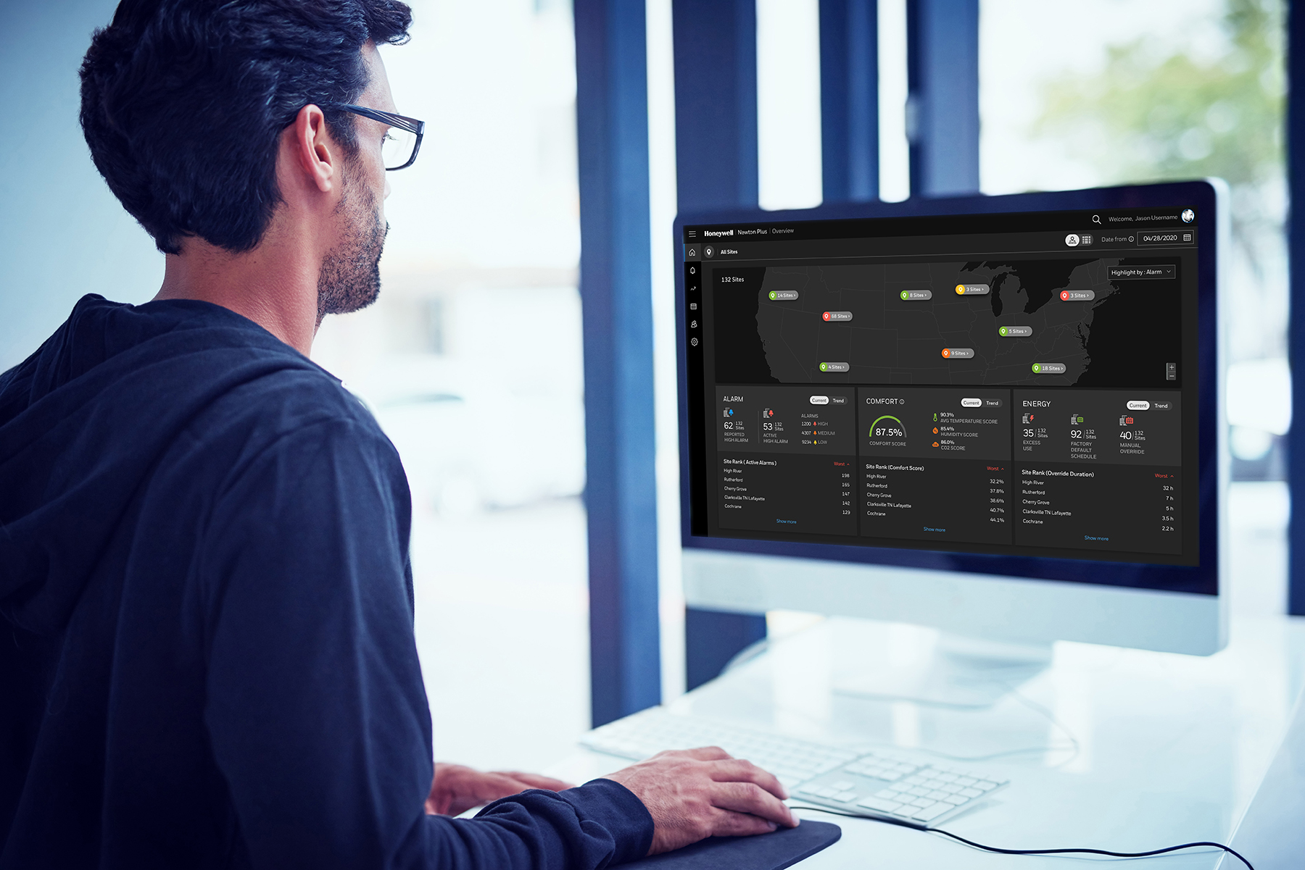
Our Mission: assist you in achieving your goals
OCCUPANT COMFORT
OPERATIONAL & ENERGY PRODUCTIVITY
MULTI-SITE PORTFOLIO MANAGEMENT
AN ACTIVE PARTNERSHIP
Notes:
Honeywell SaMBa, which is short for small and medium buildings administrator, offers you the tools that you need to achieve your goals and was built from the ground up to drive Occupant comfort, Operational and Energy Productivity and multi-site portfolio Management across the many buildings that you have
Lets look at some of the unique Honeywell SaMBa features and benefits in a bit more details

Slide 6
Occupant comfort
Easy Comfort Control
Comfort Index
Increased Uptime
Safety: Indoor Air Quality
You want your customers and employees to have confidence they are in a safe and comfortable environment.
From temperature to air quality, Honeywell’s Small and Medium Building Administrator helps you be in control.
Notes:
Lets start with Occupant comfort –
A comfortable environment makes for returning customers and happy, more productive employees.
At this point in time this will be top of mind for all facility and property managers - As you want to give your customers, employees and occupants the confidence that when they are in your facility they are in a safe and comfortable environment
This requires you to be able to control building conditions and with Honeywell SaMBa you are in control and will get the optimum uptime from your infrastructures from wherever you are:
From Monitoring and controlling comfort parameters in each area of your buildings, as well as indoor air quality
To be able to visualise comfort level, using a comfort index based on Ashrea standard, for quick view of potential problem area or building or to Benchmark each area and facilities against each other’s to leverage best practice

Slide 7
Operational productivity
Energy Management
Scheduling
Intelligent Alarm Management
Increased Uptime
Risk Mitigation
Gather data and insights into your facilities that will help you minimize downtime and lower operating costs. For example; schedule thermostats, receive alerts if temperatures fall outside your set parameters anywhere, at any site.
Notes:
The ability to view data and insights for your facilities in one easy to use dashboard, will help you optimise operational and Energy Productivity – by minimizing downtimes and identify opportunities to lower operating costs.
From an unobtrusive installation and simple maintenance that minimise disruptions and support ongoing business continuity.
To remote monitoring and intelligent alarm management help prevent unexpected breakage, damage and downtime – keeping you open for business.
Manage energy and deliver improvement in sustainability and carbon emissions reduction
And an Intuitive dashboards showing alerts and trends means you can continuously further optimize operational efficiencies.
Lets take temperature as an example:
Manage energy consumption and scheduling by setting thermostats to heat up a building or a zone within a that building to a certain temperature, and only when required
Intelligent alarm management lets you receive alerts if and when temperatures fall outside your set of parameters – and identify any increase in energy consumption if that temperature is too high or any potential downtime if the temperature falls below parameters – with can indicate potential equipment failure or risk of failure, and give you an opportunity and time to mitigate any risks, which depending on your vertical could be tenant complaints in an office building or losing potential trade and revenues in a grocery or restaurant, if patrons are not comfortable enough to stay.

Slide 8
Multi-site portfolio management
Easy-to-use Central Management
Remote/Secure Access
Scalable from 10’s to 1000’s of sites
Modular solution to fit your needs
Cybersecurity built-in from the beginning
Risk Mitigation
Traditional large building automation systems bring these to you, with significant investment. Honeywell’s Small and Medium Building Administrator is designed to deliver an enterprise experience with a Return on Investment that makes sense.
Notes:
Honeywell Small and Medium Building Administered is designed to deliver that multi-site, enterprise level experience but with a return on investment and features that will make sense to you
• Intuitive and Easy-to-use central management platform
• Remote and secured access
• A modular solution that is scalable from ten’s to thousands of sites and is flexible enough to grow with your business
All this with the highest level of cyber security that you can expect from a Honeywell solution, built in from the beginning.
Honeywell makes is simple

Slide 9
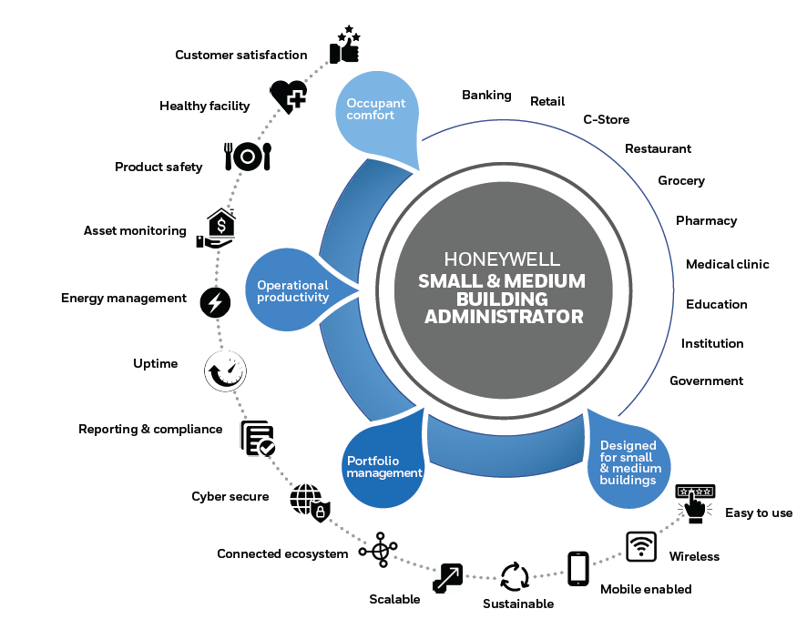
Proven technologies
TO MEET YOUR APPLICATIONS
Notes:
No matter your sector of activity and your needs, Honeywell Small and Medium Building Administrator will help you deliver value to your business when it comes to Occupant comfort, Operational productivity and Multi-site portfolio Management
From a government and office buildings where occupant comfort means increased employee productivity, to a retail environment where comfort means returning shoppers spending more time in your store
A restaurants where efficiency means increased uptime and the ability to serve more customers to a medical clinic where energy management and risk mitigation mean less refrigeration units downtimes leading to less waste of expensive drugs and medication
To a school or university managing a few buildings on one campus to a facility manager with a portfolio of convenience stores located in different regions or even geographies, where portfolio management means still be able to deliver great benefits to your customers remotely.
Honeywell is there, ready to meet your goals with you.

Slide 10

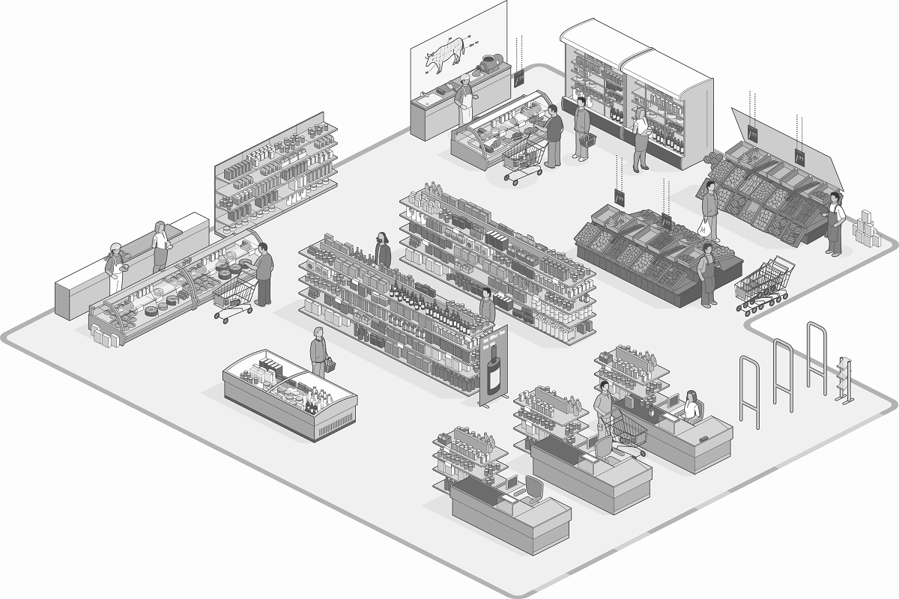

Proven technologies
END-TO-END COVERAGE
BMS | SECURITY
HEALTHY BUILDING SCORE
TRENDS & ANALYTICS
BUILDING MANAGER
ALERTS, SOPS & IM
CLOUD, APP NOTIFICATION
DEHUMIDIFICATION
MONITORING & CONTROL
ENHANCED
AIR QUALITY
ANTI-MICROBIAL THERMOSTAT
PURIFIER
WAYFINDING
DIRECTION
ENHANCED AIRQUALIY
PURIFIER
TEMPERATURE SCREENING
PPE
DETECTION
TEMPERATURE SCREENING
UV LIGHT
STERILIZATION
TOUCHLESS
ACCESS CONTROL
AIR
PURIFIER
PEOPLE COUNTING
FLOW MONITORING
UV LIGHT
STERILIZATION
LOCKDOWN
MONITORING
LOCKDOWN
MONITORING

Slide 11
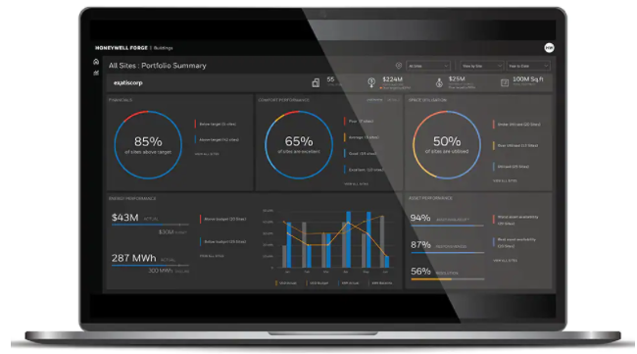
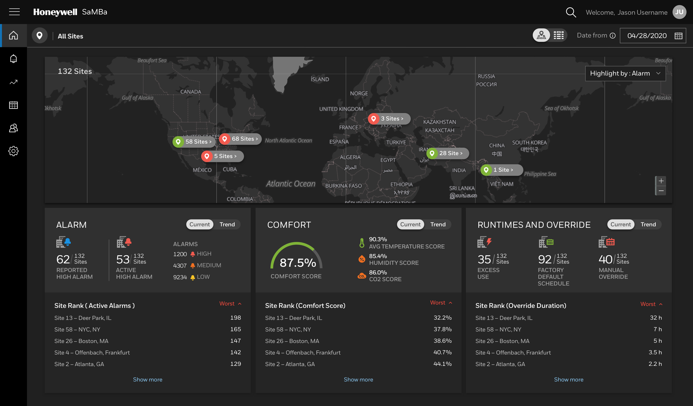
HONEYWELL SAMBA
POWERED BY HONEYWELL FORGE
Notes:
Honeywell’s SaMBa dashboard was built from to meet the needs of Multi-site Small and Medium Building owners to have a portfolio level view of their estate and the need quickly identify any potential issues and get to the granular data and building control features that matter most – fast.
The dashboard is set up to show relevant data with a:
Multi-Site management view – which gives the ability to quickly see all sites from one location – and a calendar access for portfolio scheduling.
And portfolio overview of
Occupant Comfort indicator – at portfolio level
Operational Productivity Key performance indicators showing overall Alarms and Energy scores as well as the worst performing sites
Granular data and insights on each site can then be accessed from the dashboard as required

Slide 12
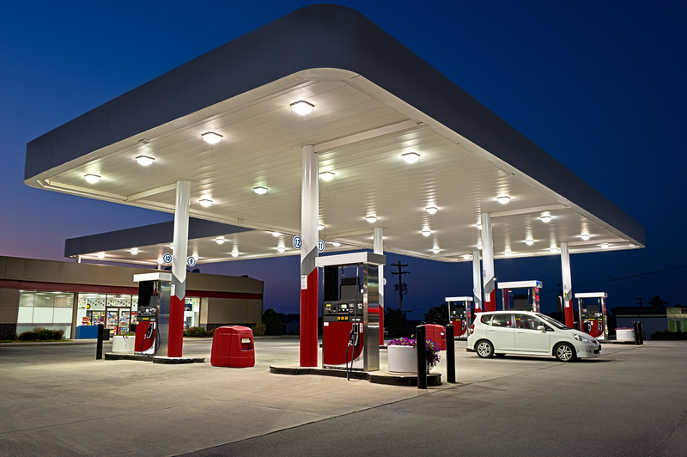




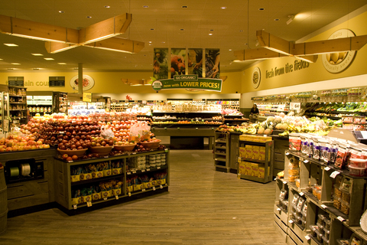
we solve problems everywhere
Convenience/Petrol Stores
Pharmacy
Light Medical
OCCUPANT COMFORT
OPERATIONAL PRODUCTIVITY
MULTI-SITE PORTFOLIO MANAGEMENT
Restaurants
Retail
Grocery
YOUR FLEET OF MULTI-SITE BUILDINGS
Notes:
Honeywell Small and Medium Building administrator will solve for the needs of facility managers in virtually all sector of activities.
But as the world trying to get back to a new normal step by step, in some sectors, the key priority has well and truly shifted towards delivering occupant comfort and bring people back into facilities that desperately need traffic in order to survive such as retail, convenience stores, groceries and restaurant.
But also in facilities providing critical services to the communities, such as medical clinics, where people need the confidence and peace of mind that they can visit to ask for help whilst also keeping key workers like doctors and nurses safe so that they can carry on doing their work.

Slide 13
Let’s GET STARTED
1
2
3
4
5
Analyze
Current Situation
Discus your Policies
and Standards
Report and Recommendations
Prioritize Your Needs
Financial Proposal
Let Us Help Get You To Your Goals!
Notes:
So let us help you and as we start on this journey together, this is what you can expect from us as we work with you the deliver the best value and customer experience possible:
#1 - Expert walkthrough and interviews with Key stake-holder of your team. Facilities, IT, Finance, and more.
#2 - Review, analyze, and validate current policies and standard and processes in place
#3 - Issue a recommendations report, complete with challenges, opportunities, dependencies, and an action plan
#4 - Rank the solutions during a co-ideation session, prioritized by criticality, speed, quality, and impact of implementation
#5 - Detailed proposal outlining discrete point solutions, timelines, costs and a proposal to digitize and communicate key building / occupant metrics

Slide 14

Why honeywell sMB?
Proven expertise with global reach
Let Us Help Get You To Your Goals!
Notes:
So why Honeywell SaMBa?
A solution developed to meet the need of facility managers with small and medium multi-sites portfolios at a return on investment that makes sense.
A solution that will deliver business benefits to customers everywhere, whatever their sector of activity.
From 10’s of buildings to 1000’s buildings
Honeywell provides a proven expertise with a global reach – Let us help you to your goals!

Slide 15
Thank you
#HoneywellSMB
Notes:
Thank you
I hope that you have found this introduction to Honeywell Small and Medium Business Administrator or interest and that we can work together to see what value we can deliver to your business.

