Slide 1
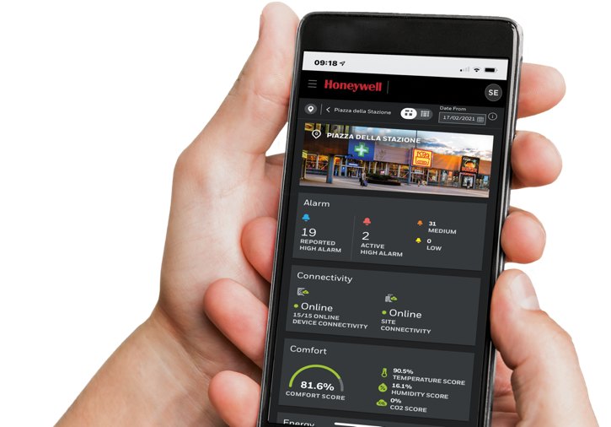
Multisite building management
Small and medium building administrator

Slide 2
About us
HONEYWELL is a
FORTUNE
Company and a trusted partner whose expertise and knowledge you can rely on
Our world-class technology and 125 years of proven building experience have been re-invested in developing an intuitive plug and play enterprise solution for small and medium building estate management.
Affordable, scalable and flexible, Honeywell Small and Medium Buildings Administrator can achieve a return on investment within just *ten months, no matter what industry you operate in.
*energy and productivity measured together
100

Slide 3
About us
125 YEARS
Of proven
Building solutions
More than 10 million buildings
More than 2100 engineers dedicated to building controls
Building solutions in more than 75 countries
More than 32,000 partner channels
More than 4000 patents for building controls
Largest pure player in building automation
Solutions designed to deliver vertical based outcome

Slide 4
SMALL AND MEDIUM BUILDING ADMINISTRATOR
Who where WHY
FACILITY MANAGER and ENERGY MANAGERS with a portfolio of SMALL AND MEDIUM MULTI-SITE FACILITIES in any vertical.
PLUG-AND-PLAY
EASY TO:
Install
Configure
Maintain
Minimizing disruptions
Wireless connectivity
WHO NEED TO
Optimize the ENERGY and OPERATIONAL COSTS while increasing the Occupant comfort (specially during pandemic times).
REMOTE, SECURE AND SCALABLE
Powered by Honeywell Forge REAL-TIME DASHBOARD REPORTING allows you to Monitor and Control your assets and Scale from 10’s to 1,000’s sites.
OUT OF REACH
Available BMS systems are EXPENSIVE and COMPLEX as they are not designed for small and medium buildings.
SMART OPEX
Subscription-based offering focused on Low Capex and an Ongoing Opex based on Value Creation to ACHIEVE ROI FAST.
Honeywell Small and Medium Building Administrator

Slide 5
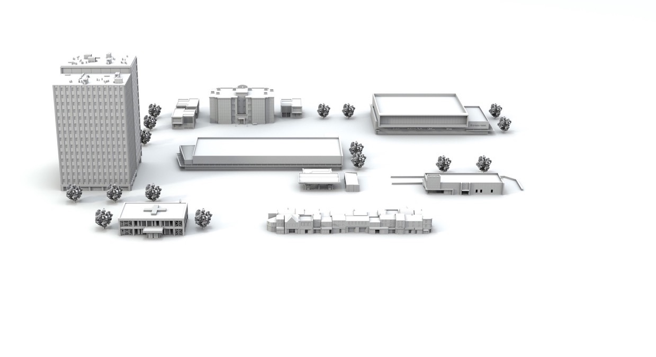
Small and medium building administrator
Click each button
BUILDING MANAGEMENT SIMPLIFIED
NON-FOOD RETAIL
SMALL AND MEDIUM COMMERCIAL
HEALTHY BUILDINGS
MANAGED SERVICES
LIGHT MEDICAL
FOOD RETAIL
CONVENIENCE
STORE
QUICK SERVICE RESTAURANTS
OCCUPANT COMFORT
OPERATIONAL AND PRODUCTIVITY EFFICIENCY
MULTI-SITE MANAGEMENT

Slide 6
Small and medium building administrator
Click each button
BUILDING MANAGEMENT SIMPLIFIED
NON-FOOD RETAIL
SMALL AND MEDIUM COMMERCIAL
HEALTHY BUILDINGS
MANAGED SERVICES
LIGHT MEDICAL
FOOD RETAIL
CONVENIENCE
STORE
QUICK SERVICE RESTAURANTS
Click here
OCCUPANT COMFORT
OPERATIONAL AND PRODUCTIVITY EFFICIENCY
MULTI-SITE MANAGEMENT

Slide 7
Small and medium building administrator
Click each button
BUILDING MANAGEMENT SIMPLIFIED
NON-FOOD RETAIL
SMALL AND MEDIUM COMMERCIAL
HEALTHY BUILDINGS
MANAGED SERVICES
LIGHT MEDICAL
FOOD RETAIL
CONVENIENCE
STORE
QUICK SERVICE RESTAURANTS
Click here
OCCUPANT COMFORT
OPERATIONAL AND PRODUCTIVITY EFFICIENCY
MULTI-SITE MANAGEMENT

Slide 8
Small and medium building administrator
Click each button
BUILDING MANAGEMENT SIMPLIFIED
NON-FOOD RETAIL
SMALL AND MEDIUM COMMERCIAL
HEALTHY BUILDINGS
MANAGED SERVICES
LIGHT MEDICAL
FOOD RETAIL
CONVENIENCE
STORE
QUICK SERVICE RESTAURANTS
Click here
OCCUPANT COMFORT
OPERATIONAL AND PRODUCTIVITY EFFICIENCY
MULTI-SITE MANAGEMENT

Slide 9
Small and medium building administrator
Click each button
BUILDING MANAGEMENT SIMPLIFIED
Click here
NON-FOOD RETAIL
SMALL AND MEDIUM COMMERCIAL
HEALTHY BUILDINGS
MANAGED SERVICES
LIGHT MEDICAL
FOOD RETAIL
CONVENIENCE
STORE
QUICK SERVICE RESTAURANTS
OCCUPANT COMFORT
OPERATIONAL AND PRODUCTIVITY EFFICIENCY
MULTI-SITE MANAGEMENT

Slide 10
Small and medium building administrator
Click each button
BUILDING MANAGEMENT SIMPLIFIED
NON-FOOD RETAIL
Click here
SMALL AND MEDIUM COMMERCIAL
HEALTHY BUILDINGS
MANAGED SERVICES
LIGHT MEDICAL
FOOD RETAIL
CONVENIENCE
STORE
QUICK SERVICE RESTAURANTS
OCCUPANT COMFORT
OPERATIONAL AND PRODUCTIVITY EFFICIENCY
MULTI-SITE MANAGEMENT

Slide 11
Small and medium building administrator
Click each button
BUILDING MANAGEMENT SIMPLIFIED
NON-FOOD RETAIL
SMALL AND MEDIUM COMMERCIAL
HEALTHY BUILDINGS
Click here
MANAGED SERVICES
LIGHT MEDICAL
FOOD RETAIL
CONVENIENCE
STORE
QUICK SERVICE RESTAURANTS
OCCUPANT COMFORT
OPERATIONAL AND PRODUCTIVITY EFFICIENCY
MULTI-SITE MANAGEMENT

Slide 12
Small and medium building administrator
Click each button
BUILDING MANAGEMENT SIMPLIFIED
NON-FOOD RETAIL
SMALL AND MEDIUM COMMERCIAL
HEALTHY BUILDINGS
MANAGED SERVICES
LIGHT MEDICAL
FOOD RETAIL
CONVENIENCE
STORE
QUICK SERVICE RESTAURANTS
Click here
OCCUPANT COMFORT
OPERATIONAL AND PRODUCTIVITY EFFICIENCY
MULTI-SITE MANAGEMENT

Slide 13
Small and medium building administrator
Click each button
BUILDING MANAGEMENT SIMPLIFIED
NON-FOOD RETAIL
SMALL AND MEDIUM COMMERCIAL
HEALTHY BUILDINGS
MANAGED SERVICES
LIGHT MEDICAL
FOOD RETAIL
CONVENIENCE
STORE
QUICK SERVICE RESTAURANTS
Click here
OCCUPANT COMFORT
OPERATIONAL AND PRODUCTIVITY EFFICIENCY
MULTI-SITE MANAGEMENT

Slide 14
Small and medium building administrator
Click each button
BUILDING MANAGEMENT SIMPLIFIED
NON-FOOD RETAIL
SMALL AND MEDIUM COMMERCIAL
HEALTHY BUILDINGS
Click here
MANAGED SERVICES
LIGHT MEDICAL
FOOD RETAIL
CONVENIENCE
STORE
QUICK SERVICE RESTAURANTS
OCCUPANT COMFORT
OPERATIONAL AND PRODUCTIVITY EFFICIENCY
MULTI-SITE MANAGEMENT

Slide 15
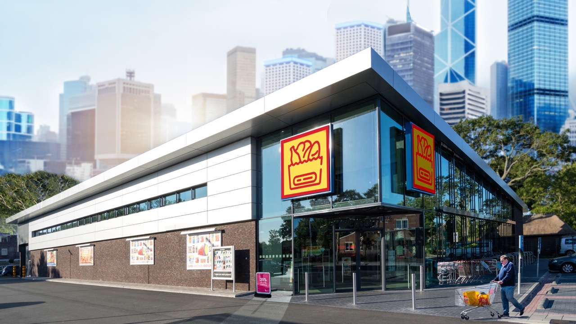
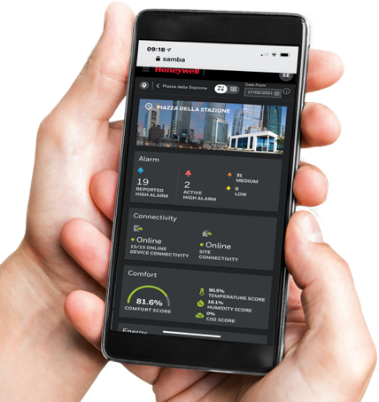
SMALL AND MEDIUM FOOD RETAIL

Slide 16
FOOD RETAIL
challenge
ENSURING UNINTERRUPTED SERVICE IS CRITICAL TO MAINTAINING PROFITABILITY
Downtime can seriously increase overhead, loss of inventory as well as reduce foot traffic.
Poor visibility of HVAC even though it accounts for up to 44% of energy consumption
Erratic lighting discourages customers from entering or remaining in store
High temperatures spoil ambient and fresh food caused by unreliable air-conditioning
Faulty refrigeration and freezers, or just doors left open by customers, result in discarded stock with huge financial impact
Service call-outs to resolve onsite issues are frequent and expensive
Triggered alarms are often ignored when staff are too busy to act quickly
High energy consumption represents the most significant percentage of operating costs

Slide 17
FOOD RETAIL
VALUE ADDED
REDUCE
ENERGY
with automatic HVAC control based on machine learning to optimize setpoints.
REDUCE LOSS OF PERISHABLES
with awareness of High and/or Low temperatures through
PROACTIVE
ALARMING
REMOTE
MONITORING
allows you to see the sites and trouble shoot remotely
REDUCING
SERVICE CALLS
30%
1
IMPROVE OCCUPANT
COMFORT
10%
and customer satisfaction
2
UP TO
1. Average Honeywell customer sites across a monthly reporting period
2. https://hbr.org/2017/03/research-stale-office-air-is-making-you-less-productive

Slide 18
FOOD RETAIL
ROOF TOP UNIT HEALTH CHECK
Reduce the time spent on site checking your HVAC equipment
EMPLOYEE PRODUCTIVITY
Increased through temperature, humidity and air quality control
UP TO
10%
30%
UP TO
2
1
REDUCE ENERGY
Through HVAC & Lighting Control
FACILITIES
REMOTE REACTIVE
Reduce site call outs by troubleshooting with remote fix.
OPEX
SAVINGS
CRITICAL ALARM MONITORING
React immediately to issues on site to reduce downtime
SITE CALL OUTS
Ensure the right trade goes to site with first time fix – Through remote diagnosis and escalation on repeat call outs
REDUCE LOSS OF PERISHABLES
With monitoring of High and/or Low temperatures
1. From customer data
2. https://hbr.org/2017/03/research-stale-office-air-is-making-you-less-productive

Slide 19
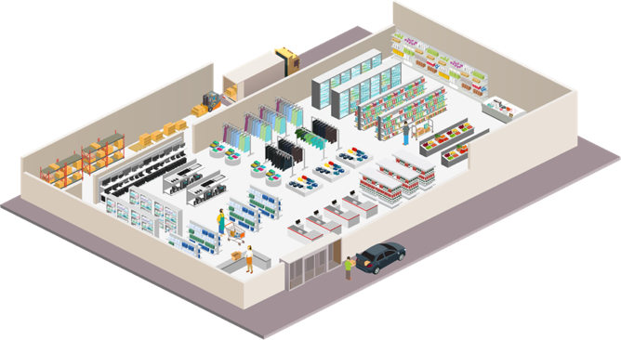
FOOD RETAIL
REFRIDGERATION
MONITORING
IAQ SENSORS
TEMPERATURE, VOC, CO₂, PM2.5
VENTILATION
INCREASE FRESH AIR CIRCULATION
LIGHTING LEVEL CONTROL
AIR QUALITY
MONITORING
HEALTHY BUILDING KPIS
AUTOMATIC REPORTS COMPLIANCE
CONSUMPTION TRENDS
REPORTING
PC/MOBILE ACCESS
REMOTE MANAGEMENT
CO₂ SENSOR
MONITORING
LIGHTING & HVAC
SCHEDULE & TRACKING
TEMPERATURE & HUMIDITY SENSOR
MONITORING
WIRELESS
CONNECTIVITY
ALERTS, SOPS & IM
SECURITY
OCCUPANT
COMFORT
OPERATIONAL
PRODUCTIVITY
MULTI-SITE
MANAGEMENT
Results are not necessarily typical and are based on Honeywell “before and after” analysis at selected customer sites. Such analysis compared site performance before deployment of Honeywell solutions to post deployment performance, without controlling for other factors that may have affected results. Your results may vary.

Slide 20
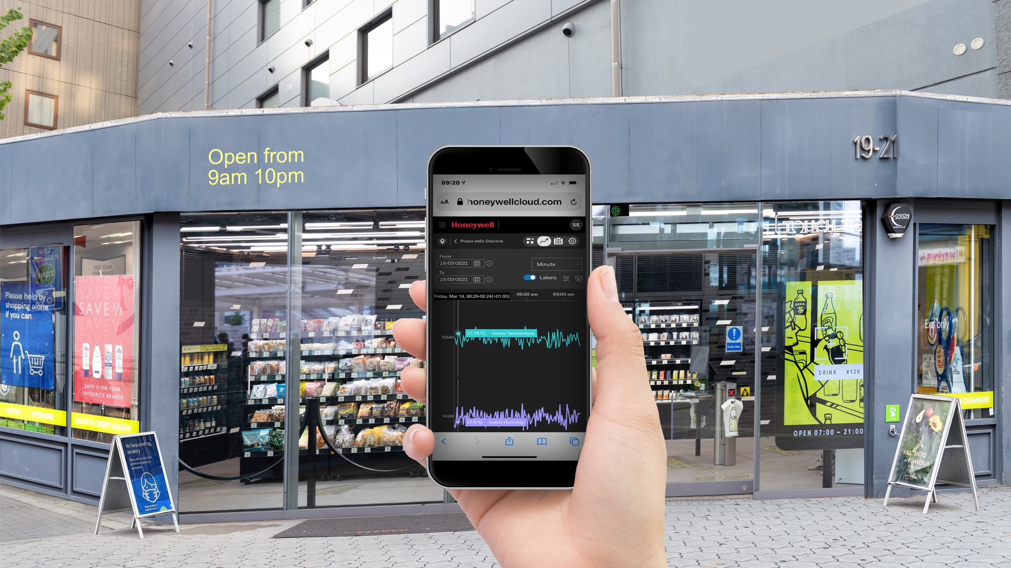
SMALL AND MEDIUM Convenience store

Slide 21
Convenience store
challenge
ENSURING UNINTERRUPTED SERVICE IS CRITICAL TO MAINTAINING PROFITABILITY
Downtime can seriously increase overheads, loss of inventory as well as reduce footfall.
Poor visibility of HVAC even though it accounts for up to 44% of energy consumption
Easy to install on current sites and new builds
Erratic lighting discourages customers from entering or remaining in store
High temperatures spoil ambient and fresh food caused by unreliable air-conditioning
Faulty refrigeration and freezers, or just doors left open by customers, result in discarded stock with huge financial impact
Service call-outs to resolve onsite issues are frequent and expensive
Triggered alarms are often ignored when staff are too busy to act quickly
High energy consumption represents the most significant percentage of operating costs

Slide 22
Convenience store
VALUE ADDED
REDUCE
ENERGY
with automatic HVAC control based on machine learning to optimize setpoints.
REDUCE LOSS OF PERISHABLES
with awareness of High and/or Low temperatures through
PROACTIVE
ALARMING
REMOTE
MONITORING
allows you to see the sites and trouble shoot remotely
REDUCING
SERVICE CALLS
30%
1
IMPROVE OCCUPANT
COMFORT
10%
and customer satisfaction
2
UP TO
1. Average Honeywell customer sites across a monthly reporting period
2. https://hbr.org/2017/03/research-stale-office-air-is-making-you-less-productive

Slide 23
convenience store
ROOF TOP UNIT HEALTH CHECK
Reduce the time spent on site checking your HVAC equipment
EMPLOYEE PRODUCTIVITY
Increased through temperature, humidity and air quality control.
UP TO
10%
30%
UP TO
2
1
REDUCE ENERGY
Through HVAC & Lighting Control
FACILITIES
REMOTE REACTIVE
Reduce site call outs by troubleshooting with remote fix.
OPEX
SAVINGS
CRITICAL ALARM MONITORING
React immediately to issues on site to reduce downtime
SITE CALL OUTS
Ensure the right trade goes to site with first time fix – Through remote diagnosis and escalation saving on repeat call outs
REDUCE LOSS OF PERISHABLES
With monitoring of High and/or Low temperatures
1. Average Honeywell customer sites across a monthly reporting period
2. https://hbr.org/2017/03/research-stale-office-air-is-making-you-less-productive

Slide 24
convenience store
REFRIDGERATION
MONITORING
IAQ SENSORS
TEMPERATURE, VOC, CO₂, PM2.5
VENTILATION
INCREASE FRESH AIR CIRCULATION
LIGHTING LEVEL CONTROL
AIR QUALITY
MONITORING
HEALTHY BUILDING KPIS
AUTOMATIC REPORTS COMPLIANCE
CONSUMPTION TRENDS
REPORTING
PC/MOBILE ACCESS
REMOTE MANAGEMENT
CO₂ SENSOR
MONITORING
LIGHTING & HVAC
SCHEDULE & TRACKING
TEMPERATURE & HUMIDITY SENSOR
MONITORING
WIRELESS
CONNECTIVITY
ALERTS, SOPS & IM
SECURITY
OCCUPANT
COMFORT
OPERATIONAL
PRODUCTIVITY
MULTI-SITE
MANAGEMENT
Results are not necessarily typical and are based on Honeywell “before and after” analysis at selected customer sites. Such analysis compared site performance before deployment of Honeywell solutions to post deployment performance, without controlling for other factors that may have affected results. Your results may vary.

Slide 25
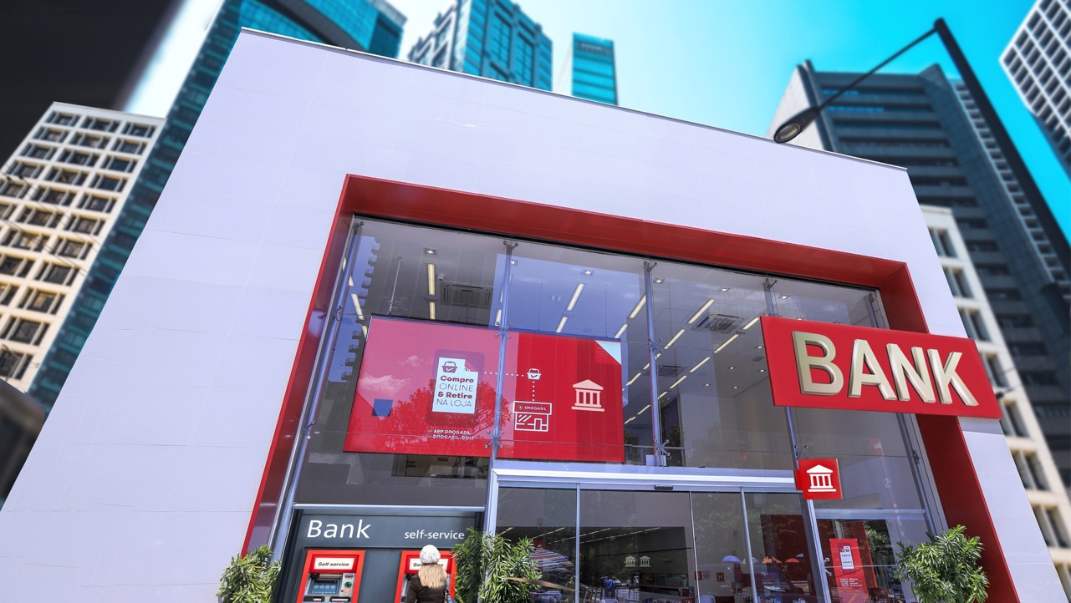
SMALL AND MEDIUM COMMERCIAL OFFICES

Slide 26
SMALL and Medium Commercial offices
CHALLENGEs
IMPROVE OCCUPANT COMFORT TO OPTIMIZE PERFORMANCE AND OPERATIONAL PRODUCTIVITY
Provide a comfortable, healthier and safer environment for employees and guests
Maintain ideal temperature and humidity to improve efficiency and productivity
Downtime reduces revenue. Poor lighting reduces work comfort and productivity
HVAC controls are regularly switched on/off onsite resulting in too hot/cold environment and contributing to lost productivity
Mixed tenants have various needs at each location. No ability to customize by office or space type
Service call-outs to resolve onsite issues are frequent and expensive
Onsite alarms are reactive and do not pinpoint exact location and cause
High energy consumption represents the most significant percentage of operating costs

Slide 27
SMALL and Medium Commercial offices
VALUE ADDED
REDUCE
ENERGY
with automatic HVAC control based on machine learning to optimize setpoints.
PORTFOLIO MANAGEMENT
with flexible enterprise dashboards to make informed decisions with
REAL-TIME
DATA
REMOTE
MONITORING
allows you to see your sites and trouble shoot remotely
REDUCING
ONSITE VISITS
EMPLOYEE
30%
PRODUCTIVITY
1
IMPROVEMENT
through increased temperature, humidity and air quality control
10%
2
UP TO
1. Average Honeywell customer sites across a monthly reporting period
2. https://hbr.org/2017/03/research-stale-office-air-is-making-you-less-productive

Slide 28
commercial offices
ROOF TOP UNIT HEALTH CHECK
Reduce the time spent on site checking your HVAC equipment
EMPLOYEE PRODUCTIVITY
Increased through temperature, humidity and air quality control.
UP TO
10%
30%
UP TO
2
1
REDUCE ENERGY
Through HVAC & Lighting Control
FACILITIES
REMOTE REACTIVE
Reduce site call outs by troubleshooting with remote fix.
OPEX
SAVINGS
CRITICAL ALARM MONITORING
React immediately to issues on site to reduce downtime
SITE CALL OUTS
Ensure the right trade goes to site with first time fix – Through remote diagnosis and escalation saving on repeat call outs
1. Average Honeywell customer sites across a monthly reporting period
2. https://hbr.org/2017/03/research-stale-office-air-is-making-you-less-productive

Slide 29
SMALL and Medium Commercial offices
VENTILATION
INCREASE FRESH AIR CIRCULATION
LIGHTING LEVEL CONTROL
IAQ SENSORS
TEMPERATURE, HUMIDITY, VOC, CO₂, PM2.5
AIR QUALITY
MONITORING
HEALTHY BUILDING KPIS
AUTOMATIC REPORTS COMPLIANCE
CONSUMPTION TRENDS
REPORTING
PC/MOBILE ACCESS
REMOTE MANAGEMENT
CO₂ SENSOR
MONITORING
LIGHTING & HVAC
SCHEDULE & TRACKING
TEMPERATURE & HUMIDITY SENSOR
MONITORING
ALERTS, SOPS & IM
SECURITY
WIRELESS
CONNECTIVITY
OCCUPANT
COMFORT
OPERATIONAL
PRODUCTIVITY
MULTI-SITE
MANAGEMENT
Results are not necessarily typical and are based on Honeywell “before and after” analysis at selected customer sites. Such analysis compared site performance before deployment of Honeywell solutions to post deployment performance, without controlling for other factors that may have affected results. Your results may vary.

Slide 30
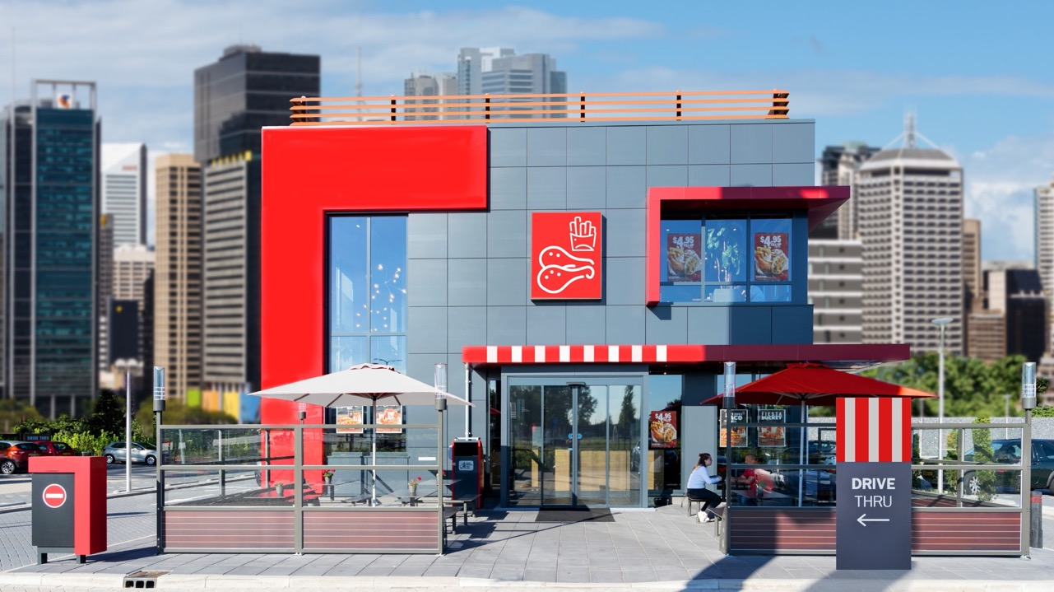
SMALL AND MEDIUM quick service restaurants

Slide 31
Quick service restaurants
CHALLENGEs
IMPROVE OCCUPANT COMFORT TO OPTIMIZE PERFORMANCE AND OPERATIONAL PRODUCTIVITY
Provide a comfortable, healthier and safer environment for employees and customers
Maintain ideal temperature and humidity to improve efficiency and productivity
Erratic lighting discourages customers from entering or remaining in store
HVAC controls are regularly switched on/off onsite resulting in too hot/cold environment
Faulty refrigeration and freezers, result in discarded food with huge financial impact
Out of hours service call-outs to resolve onsite issues are frequent and expensive
Triggered alarms are often ignored when staff are too busy to act quickly
High energy consumption represents the most significant percentage of operating costs

Slide 32
Quick service restaurants
VALUE ADDED
REDUCE
ENERGY
with automatic HVAC control based on machine learning to optimize setpoints.
REDUCE LOSS OF PERISHABLES
with awareness of High and/or Low temperatures through
PROACTIVE
ALARMING
REMOTE
MONITORING
allows you to see your sites and trouble shoot remotely
REDUCING
ONSITE VISITS
30%
CUSTOMER
1
COMFORT
improved and complaints reduced through increased temperature, humidity and air quality control
REDUCE ESTATE
TEMPERATURE
COMPLAINTS
with real time temperature adjustments
1. Average Honeywell customer sites across a monthly reporting period

Slide 33
Quick service restaurants
ROOF TOP UNIT HEALTH CHECK
Reduce the time spent on site checking your HVAC equipment
CUSTOMER COMPLAINTS
Reduce customer complaints through increased temperature, humidity and air quality control.
UP TO
30%
1
REDUCE ENERGY
Through HVAC & Lighting Control
FACILITIES
REMOTE REACTIVE
Reduce site call outs by troubleshooting with remote fix.
OPEX
SAVINGS
CRITICAL ALARM MONITORING
React immediately to issues on site to reduce downtime
SITE CALL OUTS
Ensure the right trade goes to site with first time fix – Through remote diagnosis and escalation saving on repeat call outs
REDUCE LOSS OF PERISHABLES
With monitoring of High and/or Low temperatures
1. Average Honeywell customer sites across a monthly reporting period

Slide 34
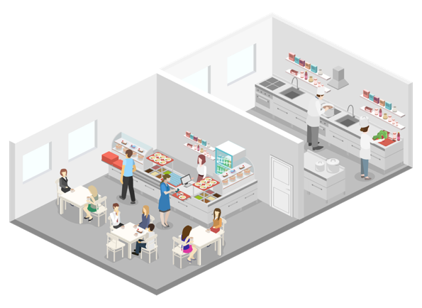
Quick service restaurants
LIGHTING LEVEL CONTROL
IAQ SENSORS
TEMPERATURE, HUMIDITY, VOC, CO₂, PM2.5
VENTILATION
INCREASE FRESH AIR CIRCULATION
AIR QUALITY
MONITORING
HEALTHY BUILDING KPIS
REFRIDGERATION
MONITORING
AUTOMATIC REPORTS COMPLIANCE
CONSUMPTION TRENDS
REPORTING
PC/MOBILE ACCESS
REMOTE MANAGEMENT
CO₂ SENSOR
MONITORING
LIGHTING & HVAC
SCHEDULE & TRACKING
TEMPERATURE & HUMIDITY SENSOR
MONITORING
ALERTS, SOPS & IM
SECURITY
WIRELESS
CONNECTIVITY
OCCUPANT
COMFORT
OPERATIONAL
PRODUCTIVITY
MULTI-SITE
MANAGEMENT
Results are not necessarily typical and are based on Honeywell “before and after” analysis at selected customer sites. Such analysis compared site performance before deployment of Honeywell solutions to post deployment performance, without controlling for other factors that may have affected results. Your results may vary.

Slide 35
SMALL AND MEDIUM LIGHT MEDICAL

Slide 36
light medical
CHALLENGES
IMPROVE OCCUPANT COMFORT TO OPTIMIZE PERFORMANCE AND OPERATIONAL PRODUCTIVITY
Provide a comfortable, healthier and safer environment for employees and patients
Maintain ideal temperature and humidity to improve efficiency and productivity
Auto-correct zones that impact health, comfort and productivity of employees
HVAC controls are regularly switched on/off onsite resulting in too hot/cold environment leading to inaccurate patient temperature and diagnosis
Faulty refrigeration and freezers, results in damaged medicine and medical devices
Service call-outs to resolve onsite issues are frequent and expensive
Multiple audible alarm types are hard to distinguish or pinpoint exact location and cause
High energy consumption represents the most significant percentage of operating costs

Slide 37
light medical
VALUE ADDED
REDUCE ENERGY
with automatic HVAC control based on AI learning to optimize setpoints.
REDUCE LOSS OF EXPENSIVE
medical perishables with awareness of High and/or Low temperatures through
PROACTIVE ALARMING
REMOTE MONITORING
allows you to see your sites and trouble shoot remotely
REDUCING ONSITE
VISITS
EMPLOYEE
PRODUCTIVITY
improvement through increased temperature, humidity and air quality control
REDUCE ESTATE
TEMPERATURE COMPLAINTS
with real time temperature adjustments
PORTFOLIO MANAGEMENT
with flexible enterprise dashboards to make informed decisions with real time data

Slide 38
light medical
ROOF TOP UNIT HEALTH CHECK
Reduce the time spent on site checking your HVAC equipment
EMPLOYEE PRODUCTIVITY
Increased through temperature, humidity and air quality control.
UP TO
10%
30%
UP TO
2
1
REDUCE ENERGY
Through HVAC & Lighting Control
FACILITIES
REMOTE REACTIVE
Reduce site call outs by troubleshooting with remote fix.
OPEX
SAVINGS
CRITICAL ALARM MONITORING
React immediately to issues on site to reduce downtime
SITE CALL OUTS
Ensure the right trade goes to site with first time fix – Through remote diagnosis and escalation saving on repeat call outs
1. Average Honeywell customer sites across a monthly reporting period
2. https://hbr.org/2017/03/research-stale-office-air-is-making-you-less-productive

Slide 39
light medical
VENTILATION
INCREASE FRESH AIR CIRCULATION
LIGHTING LEVEL CONTROL
IAQ SENSORS
TEMPERATURE, HUMIDITY, VOC, CO₂, PM2.5
AIR QUALITY
MONITORING
HEALTHY BUILDING KPIS
AUTOMATIC REPORTS COMPLIANCE
CONSUMPTION TRENDS
REPORTING
PC/MOBILE ACCESS
REMOTE MANAGEMENT
CO₂ SENSOR
MONITORING
LIGHTING & HVAC
SCHEDULE & TRACKING
TEMPERATURE & HUMIDITY SENSOR
MONITORING
ALERTS, SOPS & IM
SECURITY
WIRELESS
CONNECTIVITY
OCCUPANT
COMFORT
OPERATIONAL
PRODUCTIVITY
MULTI-SITE
MANAGEMENT
Results are not necessarily typical and are based on Honeywell “before and after” analysis at selected customer sites. Such analysis compared site performance before deployment of Honeywell solutions to post deployment performance, without controlling for other factors that may have affected results. Your results may vary.

Slide 40
SMALL AND MEDIUM NON-FOOD RETAIL

Slide 41
non-food retail
CASE STUDY
SITUATION & CHALLENGE
SOLUTION
Leading brand with 100 retail stores nationwide with combined objective to optimize the consumer experience and reduce operational costs because they had:
No visibility of performance and occupant comfort across the estate
No remote access to site for operational performance
Slow response times to site issues
Difficult and complex estate management
No visibility of lighting and air conditioning resulting in poor energy performance
Cloud-based SMB was chosen to provide single store real-time view on comfort level and asset health status, set regional schedules set across different stores and devices:
Remotely monitor temperature, relative humidity and CO₂ levels
Remotely control lighting circuits and HVAC systems
Perform benchmarking across stores for Energy consumption, Alarms, Comfort Index and other KPI’s
Receive alarms on asset malfunction or energy consumption outside of expected hours

Slide 42
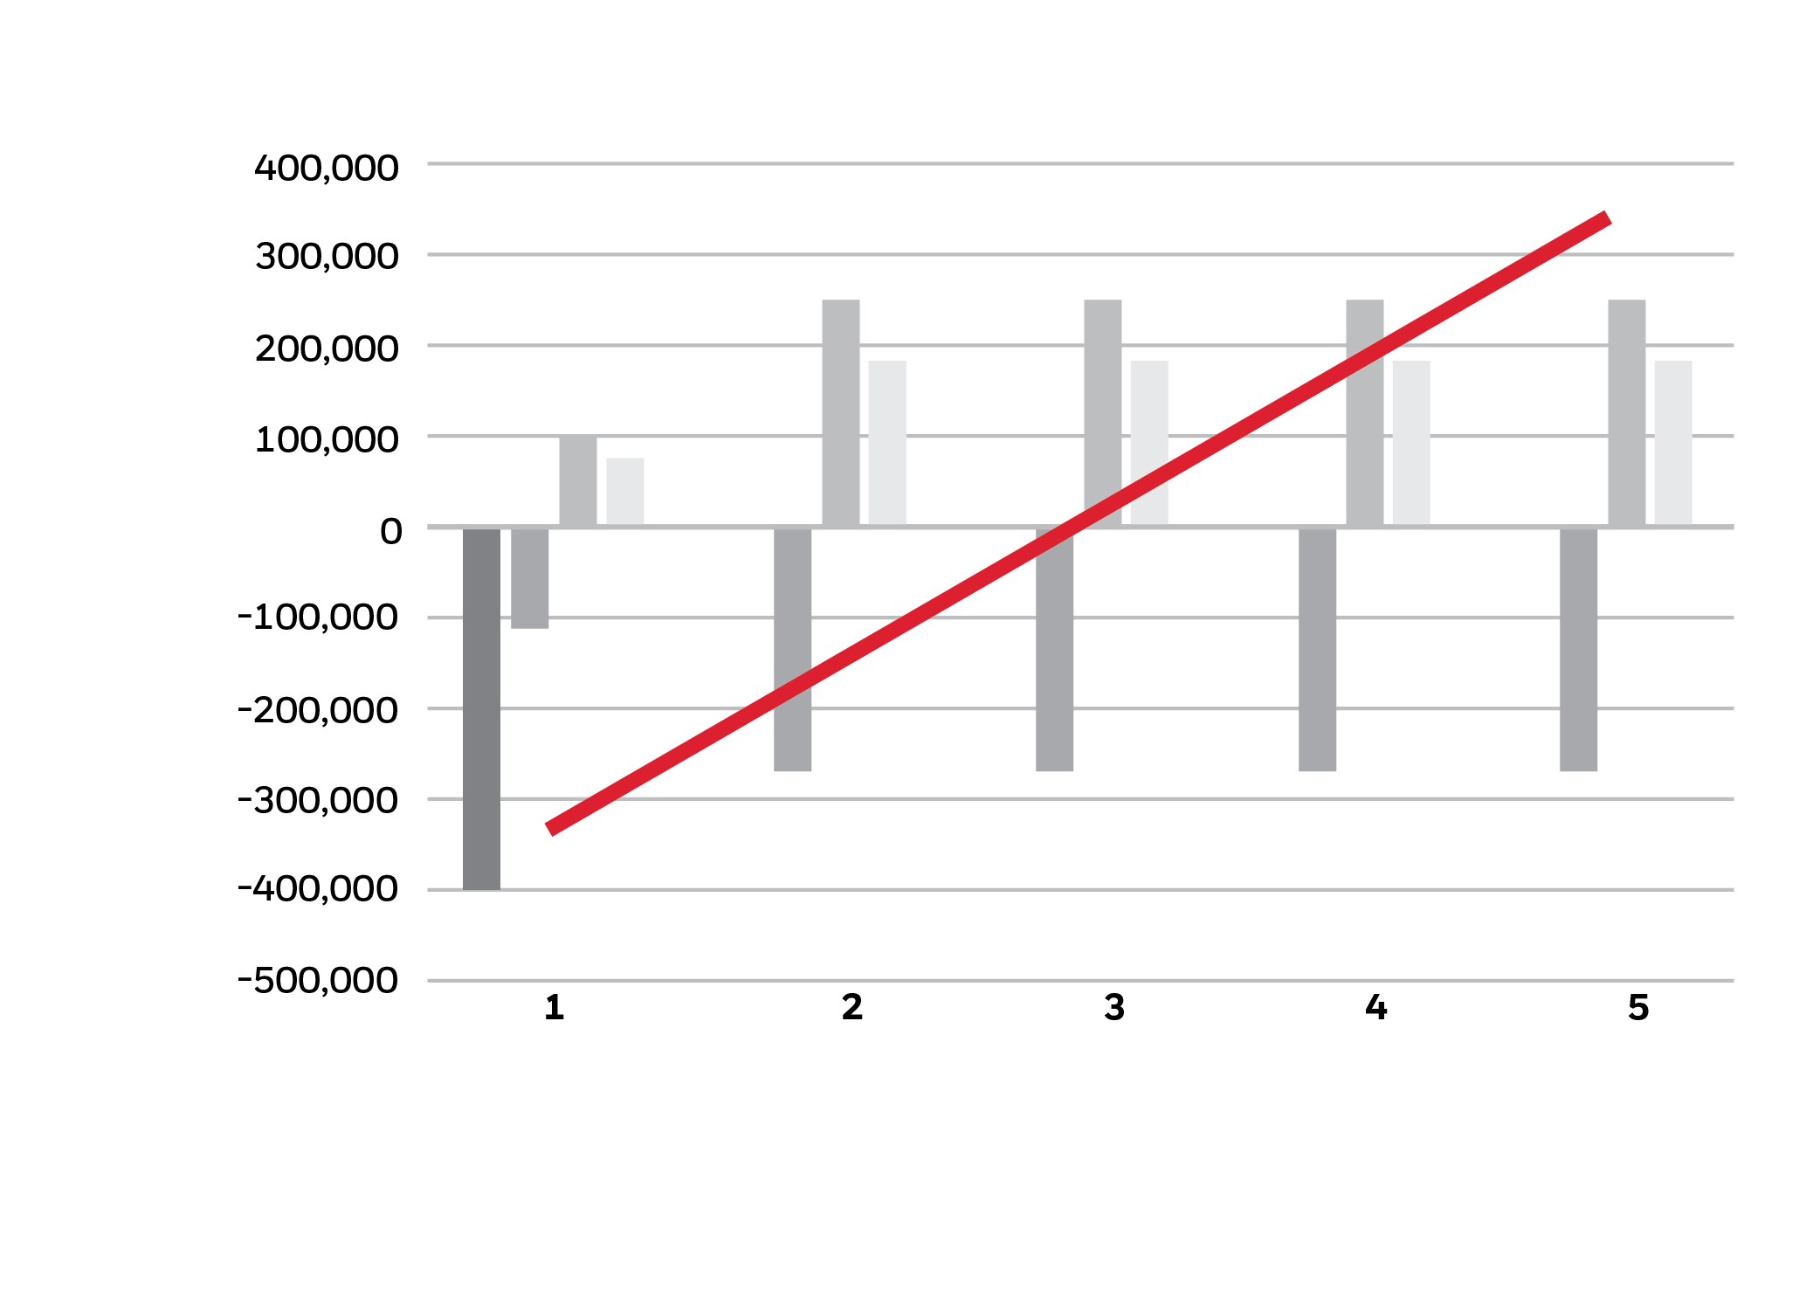
EXAMPLE SAVINGS
HONEYWELL’s recommendation for 100 stores
BENEFITS
Generates earlier savings, helping self-finance the investment
Achieving the fastest ROI
Earlier and more accurate consumption benchmark
Maximized uptime, comfort and energy and operational efficiency through Honeywell Global Remote Building Operation Centers (RBOC) support
YEAR 1 INSTALLED AND MANAGED
 |  | 1 | 2 | 3 | 4 | 5
 | Installation cost | -400,00 | 0 | 0 | 0 | 0
 | Subscription cost | -112,050 | -270,000 | -270,000 | -270.000 | -270.000
 | Energy savings | 104,580 | 252,000 | 252,000 | 252,000 | 252,000
 | Operational savings | 77,190 | 186,000 | 186,000 | 186,000 | 186,000
 | NET | -330,280 | -162,280 | 5,720 | 173,720 | 341,720
TOTAL NET
SAVINGS
$341,720

Slide 43
non-food retail
VALUE ADDED
REDUCE
ENERGY
with automatic HVAC control based on machine learning to optimize setpoints.
PORTFOLIO MANAGEMENT
with flexible enterprise dashboards to make informed decisions with
REAL-TIME
DATA
REMOTE
MONITORING
allows you to see your sites and trouble shoot remotely
REDUCING
EMPLOYEE
ONSITE VISITS
PRODUCTIVITY
IMPROVEMENT
through increased temperature, humidity and air quality control
REDUCE ESTATE
TEMPERATURE
COMPLAINTS
with real time temperature adjustments

Slide 44
Non-food retail
ROOF TOP UNIT HEALTH CHECK
Reduce the time spent on site checking your HVAC equipment
CUSTOMER COMPLAINTS
Reduce customer complaints through increased temperature, humidity and air quality control.
UP TO
30%
1
REDUCE ENERGY BY
Through HVAC & Lighting Control
REMOTE REACTIVE
Reduce site call outs by up by troubleshooting with remote fix.
FACILITIES
OPEX
SAVINGS
CRITICAL ALARM MONITORING
React immediately to issues on site to reduce downtime
SITE CALL OUTS
Ensure the right trade goes to site with first time fix – Through remote diagnosis and escalation saving on repeat call outs
1. From customer data

Slide 45
non-food retail
VENTILATION
INCREASE FRESH AIR CIRCULATION
LIGHTING LEVEL CONTROL
IAQ SENSORS
TEMPERATURE, HUMIDITY, VOC, CO₂, PM2.5
AIR QUALITY
MONITORING
HEALTHY BUILDING KPIS
AUTOMATIC REPORTS COMPLIANCE
CONSUMPTION TRENDS
REPORTING
PC/MOBILE ACCESS
REMOTE MANAGEMENT
CO₂ SENSOR
MONITORING
LIGHTING & HVAC
SCHEDULE & TRACKING
TEMPERATURE & HUMIDITY SENSOR
MONITORING
ALERTS, SOPS & IM
SECURITY
WIRELESS
CONNECTIVITY
OCCUPANT
COMFORT
OPERATIONAL
PRODUCTIVITY
MULTI-SITE
MANAGEMENT
Results are not necessarily typical and are based on Honeywell “before and after” analysis at selected customer sites. Such analysis compared site performance before deployment of Honeywell solutions to post deployment performance, without controlling for other factors that may have affected results. Your results may vary.

Slide 46
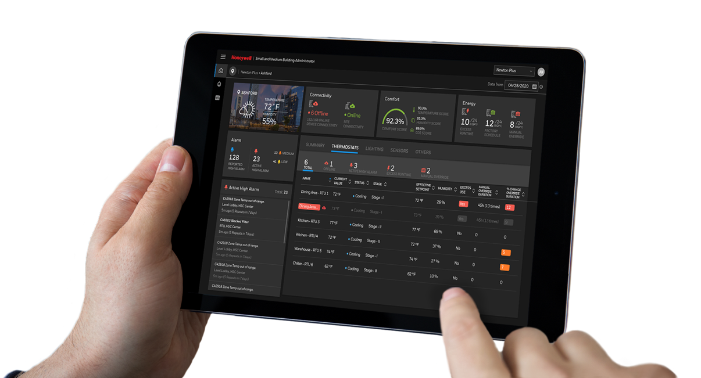
HEALTHY BUILDINGS
FOR OWNERS AND OCCUPANTS
HEALTHY BUILDING SCORE
Indicates values for VOC, CO₂, PM2.5, temperature and humidity
TRENDS
Use parameters and historic data to improve building health

Slide 47
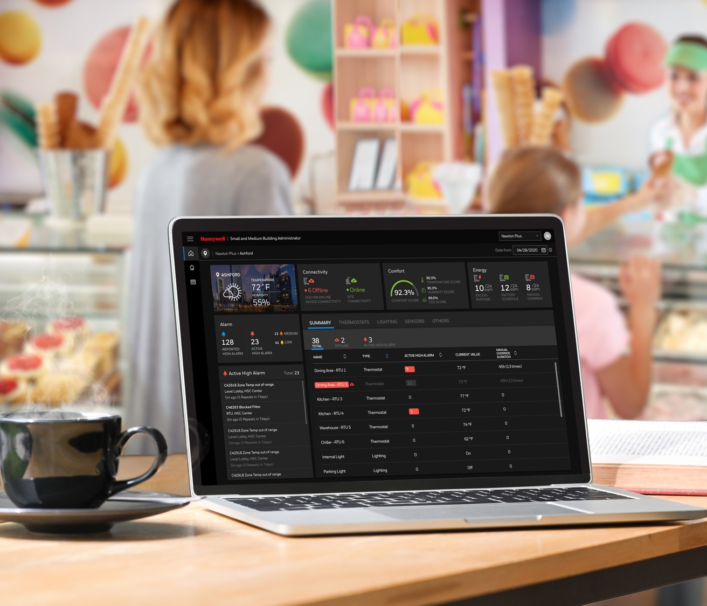
HEALTHY BUILDINGS
FOR OWNERS AND OCCUPANTS
ALARMS
Owners can mitigate risk by acting quickly when building wellness is out of range
FLOORPLAN Indicating healthy and unhealthy zones across buildings and sites
BUILDING WELLNESS INDEX
Providing sensor information in various ways including health grade: poor, average or excellent

Slide 48
SUSTAINABILITY
SOLUTIONS
Energy, Water & Facility Improvement Measures Leverage resource conservation and deferred maintenance for cost avoidance and footprint reduction
(E)nvironment
Decarbonization, Electrification, & Renewable Energy
COST
Energy Management Systems
Turn data into actionable insights for improved operational efficiency
EFFICIENCY
Remote Services
Support building monitoring, management & operational efficiency with 24/7 HON NOC
(S)ocial
Healthy Buildings,
Occupant Experience
IMPACT
(G)overnance
Dashboards &
Carbon Emissions Reporting
ACCOUNTABILITY
Distributed Generation –
Ensure energy availability when & where you need it
RISK
Flexible Power Management
Optimize energy sourcing with automation controls and energy asset monetization
RESILIENCY
Safe and Secure
Detect and protect perimeter, data, physical and human assets
Sustainability from A₂Z (Audit to net-Zero)
Notes:
Solution + Outcome (Use case to be developed for each- or across?)
Financial structure to take care of complex problems- add to 4 columns slide (s/w, services, financing)
Integration (Nareed- commercial office bldg group reporting rqmnts, integrate out data into other systems so they can report out), compliance, WELL, LEED etc. watchdog compliance…

Slide 49
Managed services FOR
Small and medium buildings
Designed specifically to meet the needs of Facility Managers of small to medium multi-site buildings, our managed service gives you total control of your estate no matter the location or challenge.
Centralized monitoring of critical building services will optimize your operation and REDUCE OVERHEADS, enabling you to make informed decisions on real data so that you can concentrate on delivering business critical activity.
BE EMPOWERED by accessing data and insights across your whole portfolio through our intuitive dashboard that is simple to use and is accessible on any mobile device.
Our innovative subscription based model provides true flexibility and scalability, giving you TOTAL CONTROL OF COSTS.

Slide 50
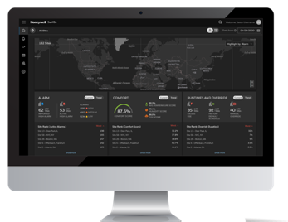
Managed services FOR
Small and medium buildings
CRITICAL ALARM MONITORING & RESPONSE
Minimize disruptions and improve safety as we monitor, triage and fix or escalate to a third party service provider 24/7
REMOTE PLANNED PREVENTATIVE MAINTENANCE
We can provide greater operational control, such as preventing equipment failure, as well as preventing known problems in the future
REMOTE REACTIVE SERVICE
Reduce overheads whilst we monitor operational changes, triage and fix, or escalate to a third party service provider
ANALYTICS
Have complete visibility of your portfolio’s energy consumption, ensuring targets are achieved with the right balance of usage and occupancy comfort
REGULAR REPORTING
Keep informed with monthly reports so that you can proactively plan your workload and make decisions based on live data

Slide 51
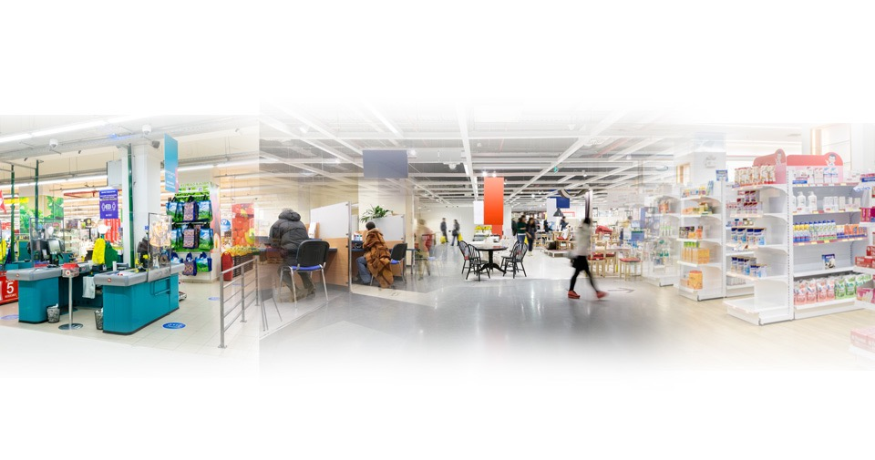
Managed services FOR
Small and medium buildings
SELF MANAGED
SYSTEM ALARM
TIME PASSES BEFORE SOMEONE NOTICES ALARM
FACILITIES TEAM CONTACTED
SERVICE PROVIDER CONTACTED
SERVICE CALL OUT
ISSUE RESOLVED
KEY BENEFITS
Fewer Touch Points
Fewer Service Calls
Quicker Resolution
Greater Uptime
Reduced cost
HONEYWELL
MANAGED
SERVICES
SYSTEM ALARM
RBOC TRIAGES AND ATTEMPTS TO RESOLVE ISSUE REMOTELY
ISSUE RESOLVED
3RD PARTY WORK ORDER CREATED
(ONLY IF NEEDED)

Slide 52
Software as a service what’s included
subscription
Pay-for-What-you-Need Model designed to Scale
Latest Software Updates for Cybersecurity
Energy Reporting, showing best/worst performing sites
Alarm Management
Global Scheduling
Supervisor Improvements
New features
Highest Level of Availability and Outsourced IT
Automated and Exportable trending held in Cloud storage
Temperature monitoring and reporting on your estate
Continuous Dashboard Improvements

Slide 53
Software as a service what’s included
Managed service
CRITICAL ALARM MONITORING
REMOTE HVAC PPM
ENERGY REPORTING
REMOTE REACTIVE
ANALYTICS
3RD PARTY ESCALATION

Slide 54
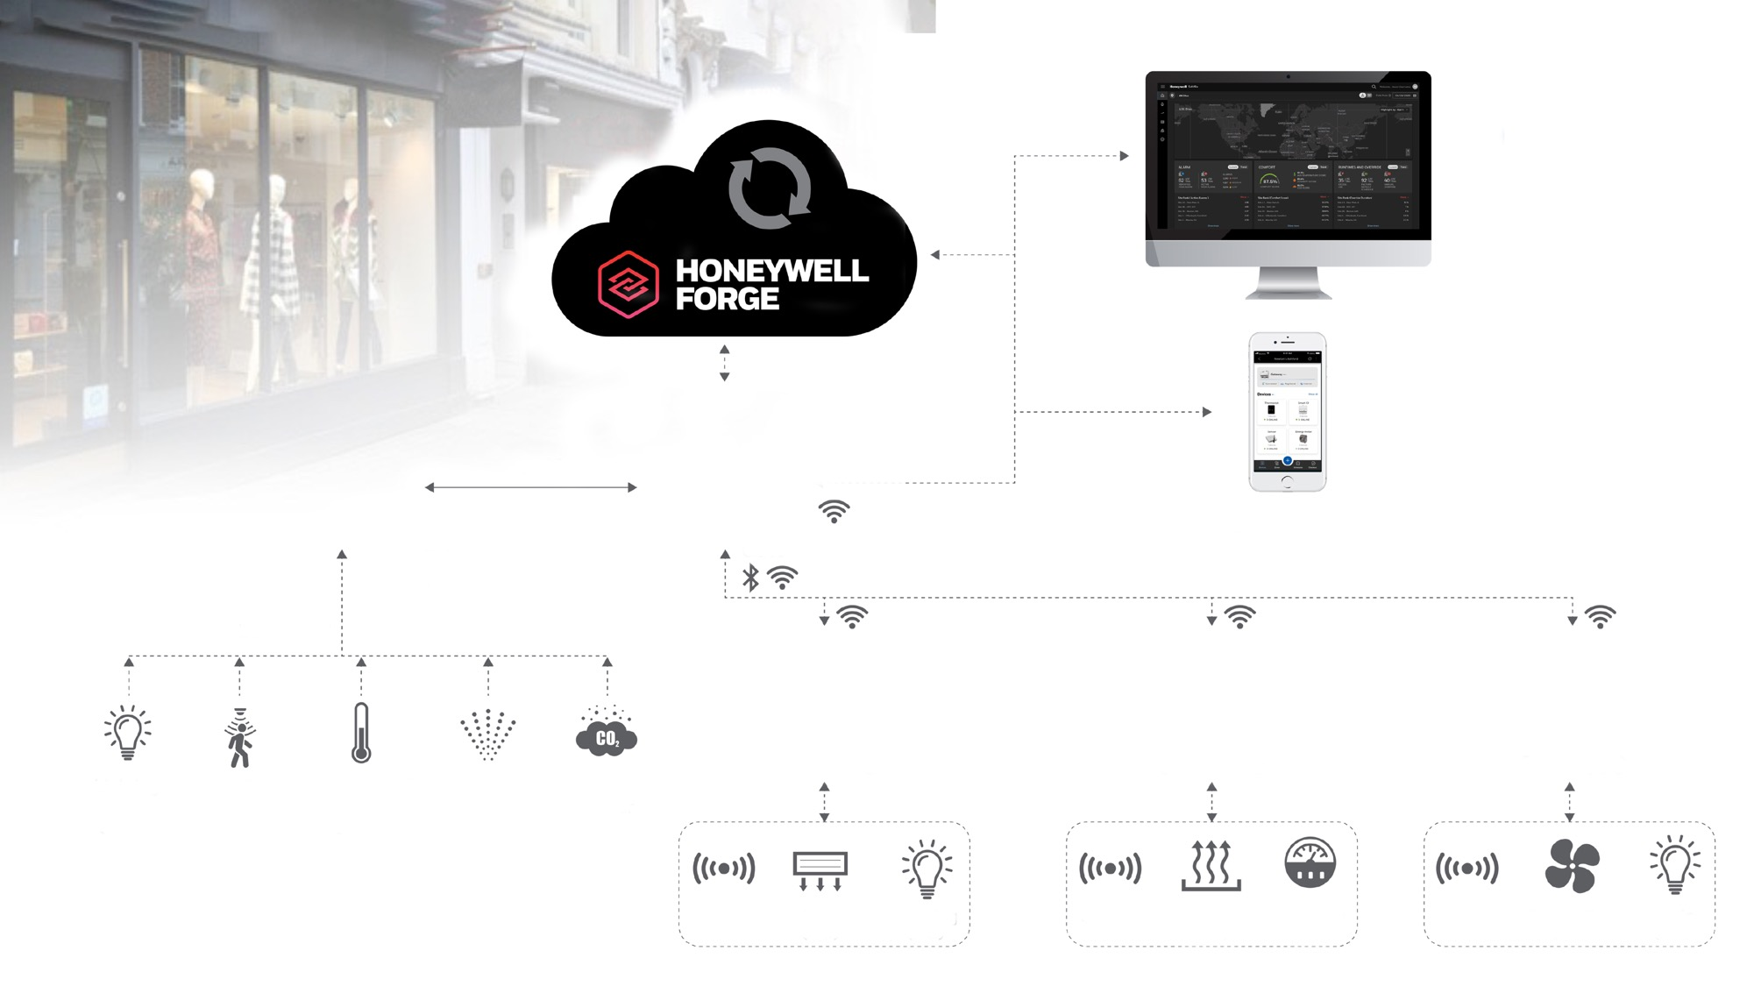
Building management
Simplified
Mobile Configuration App
MQTTS
Gateway
LoRaWAN Hub
LoRaWAN
Lighting Level Sensor
Temperature & Humidity Sensor
VOC Sensor
CO₂ Sensor
Smart IO
Smart IO
Smart IO
Sensor
VRF (I/O)
Lighting (I/O)
Sensor
Heating (I/O)
Metering (I/O)
Sensor
Extract Fan (I/O)
Lighting (I/O)

Slide 55
ENERGY MANAGEMENT
1
Predictive Maintenance insights help to optimize energy usage and costs, through Monitoring, Scheduling and Alerts.
2
Visibility on collective Facility and Energy Consumption to reduce cost.
ENERGY MANAGER
Optimize Energy consumption and Achieve Requirement Compliance while being compliant with Sustainability goals.
3
Automatic HVAC control based on machine learning algorithms that optimize setpoints.
Enhance Healthy Buildings Daily Operational View

Slide 56
1
FACILITIES MANAGEMENT
Managing Portfolio from one place and get insights by Alarms, Comfort and Energy levels.
2
Alarm Console to view, manage and edit alarm configurations.
3
Equipment Details to Monitor and Manage single devices settings.
FACILITY
MANAGER
Manage 10s to 1,000s sites and improve:
Occupant Comfort
Operational Productivity
Energy Efficiency
4
Global Schedule: to Create and Manage scheduled for the entire portfolio, a site or an individual equipment.
NEW CHALLENGE:
Implement technology selected to support re-opening plan.
Enhance Healthy Buildings Daily Operational View

Slide 57
SMALL AND MEDIUM BUILDING ADMINISTRATOR
Who where WHY
FACILITY MANAGER and ENERGY MANAGERS with a portfolio of SMALL AND MEDIUM MULTI-SITE FACILITIES in any vertical.
PLUG-AND-PLAY
EASY TO:
Install
Configure
Maintain
Minimizing disruptions
Wireless connectivity
WHO NEED TO
Optimize the ENERGY and OPERATIONAL COSTS while increasing the Occupant comfort (specially during pandemic times).
REMOTE, SECURE AND SCALABLE
Powered by Honeywell Forge REAL-TIME DASHBOARD REPORTING allows you to Monitor and Control your assets and Scale from 10’s to 1,000’s sites.
OUT OF REACH
Available BMS systems are EXPENSIVE and COMPLEX as they are not designed for Small and Medium Buildings.
SMART OPEX
Subscription-based offering focused on Low Capex and an Ongoing Opex based on Value Creation to ACHIEVE ROI FAST.
Honeywell Small and Medium Building Administrator

Slide 58
Your journey starts here
SITUATION ANALYSIS
UNDERSTAND POLICIES AND STANDARDS
REPORT AND RECOMMEND
PRIORITIZE NEEDS
FINANCIAL PROPOSAL
UNDERSTAND YOUR OPEX

Slide 59
Your journey starts here
PROJECT MOBILIZATION
SITE SURVEYS
CLIENT SIGN OFF
INSTALLATION
COMMISSIONING
CLOUD CONNECTION AND CONFIGURATION
REMOTE BUREAU OPERATIONS CENTER GO LIVE
STAFF TRAINING
ONGOING DEVELOPMENT OF SYSTEM

Slide 61
SUPPORTING INFORMATION
Notes:
OPTIONAL SLIDES

Slide 62
Hardware
Components
LORAWAN HUB
Provides Wireless sensor connectivity to the Gateway via LoRa WAN protocol
Long range, Low Energy, Secure
SMART IO
Smart & Wireless bi-directional control
Configurable IO
Is NOT a Programable Controller
Ready-to-install solution
THERMOSTAT
Thermostat monitors and controls the environment automatically.
Connected to RTU through a wired network
GATEWAY
Central Point for gathering site data
Secure communication to and from the site location
Data securely routed across the internet to the Forge
SUPERVISOR
Multi-language Management Platform
Cloud-based Web UI: Desktop, Laptop, Mobile app
Multi-site scheduling and monitoring with real-time analytics
CLICK HERE

Slide 63
INDUSTRY SOURCES
AND REFERENCES
The average commercial building wastes 30% of the energy it consumes – Energy Star
https://www.energystar.gov/buildings/resources_audience/small_medium_offices
Study: Doubling minimum ventilation rates with the use of energy-efficient HVAC systems could add eight percent in productivity gains per individual per year. Not including other potential health benefits, this equates to around $6,500 per person in a typical office building – SUNY and Syracuse medical centers and Harvard https://www.sciencedirect.com/science/article/pii/S0360132316304723
Study: Sensors and controls for Commercial Buildings can save up to 30% in facility energy costs - Pacific Northwest National Laboratory https://buildingretuning.pnnl.gov/publications/PNNL-25985.pdf
Research: Around a fifth of UK businesses spend over £250k a year on energy and 46% of business owners don’t know their company’s energy costs at all - The Telegraph and YouGov
https://www.telegraph.co.uk/business/energy-efficiency/businesses-lack-energy-knowledge/
Why Small to Medium Sized Buildings? More than 90% of the U.S. commercial building stock consist of properties under 50,000 square feet and most of these buildings lack a proper building management system to manage energy usage – Energy Star
https://www.energystar.gov/buildings/resources_audience/small_medium_offices
Study: On average, 40% of the energy costs in commercial buildings go to HVAC. Cutting that figure in half would reduce the energy costs of the average commercial building by up to 20% - DOE
https://www.pnnl.gov/main/publications/external/technical_reports/PNNL-20955.pdf
Study: Healthy Buildings Improve Employee Productivity – Harvard Business Review https://hbr.org/2017/03/research-stale-office-air-is-making-you-less-productive

